Slide 1
Exploring Coffee Quality

Slide 2

Coffee Quality Institute :
The Coffee Quality Institute(CQI) was found in 1996 and it’s Head Quarters is in California, USA.
It is a non-profitable Organization that works to improve the Quality of Coffee.
The main aim for CQI’s is to promote the coffee quality through Research, Training and by Certification Programs.
The Organization works with coffee growers, Processors, Roasters and Stakeholders to Improve the Coffee Quality and support the Development of Coffee industry

Slide 3
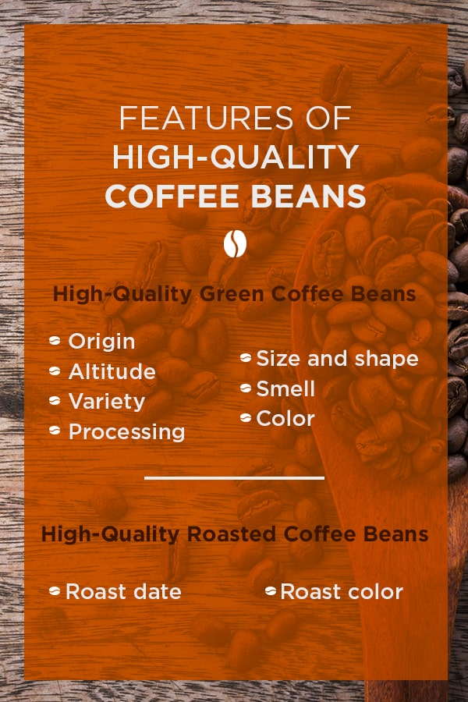
Data :
The data includes a range of information on coffee production, processing, and sensory evaluation. It also contains data on coffee genetics, soil types, and other factors that can affect coffee quality.
Sensory evaluations (coffee quality scores)
Aroma: Refers to the scent or fragrance of the coffee.
Flavor: The flavor of coffee is evaluated based on the taste, including any sweetness, bitterness, acidity, and other flavor notes.
Aftertaste: Refers to the lingering taste that remains in the mouth after swallowing the coffee.
Acidity: Acidity in coffee refers to the brightness or liveliness of the taste.
Body: The body of coffee refers to the thickness or viscosity of the coffee in the mouth.
Balance: Balance refers to how well the different flavor components of the coffee work together.
Uniformity: Uniformity refers to the consistency of the coffee
Clean Cup: A clean cup refers to a coffee that is free of any off-flavors or defects, such as sourness, mustiness, or staleness.
Sweetness: It can be described as caramel-like, fruity, or floral taste.

Slide 4
Objectives
Understand the factors that Effect coffee Quality 1
Key Attributes that Determine Coffee Quality 2
Any Correlation between processing method, Regions and Coffee quality score 3
Identify any trends or Patterns that impact overall coffee quality 4
What Variables interact to influence the total cup points 5

Slide 5

About Dataset: *. CQI provided me a Dataset which is Related to Coffee business in a CSV file. *. In that Dataset it contains 207 Rows and 31 columns. *. After understanding the Data in Excel file, I use a IDE tool called Power BI to load the Data. *. I loaded the Dataset by using CSV/text option or by copying the Path of the file into Power BI. *. Dimensions of Data is (207,31) *. In Dataset some of the Rows contain Different languages and it has some Blanks and Null Values

Slide 6
*. Columns: ID, Country of Origin, Lot Number, Altitude, Region, Number of Bags, Bag Weight, In-Country Partner, Harvest Year, Grading Date, Variety, Status, Processing Method , Aroma, Flavor, Aftertaste, Acidity, Body, Balance, Uniformity, Clean Cup, Sweetness , Overall, Defects, Total Cup Points, Moisture Percentage, Category One Defects, Quakers, Color, Category Two Defects, Expiration *. In dataset there are 5 columns which contain Blanks they are Lot Number, Altitude, Region, Variety, Processing Method. *. Important Features: Among all Columns some Features are important/considered for coffee Quality Analysis which are Altitude, Region, Processing Method , Aroma, Flavor, Aftertaste, Acidity, Body, Balance, Uniformity, Clean Cup, Sweetness , Overall, Defects, Total Cup Points, Moisture Percentage, Category One Defects, Quakers, Color, Category Two Defects. *. In defect column all the values are Zero so I deleted the column.

Slide 7
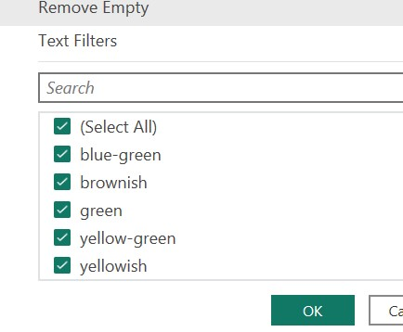
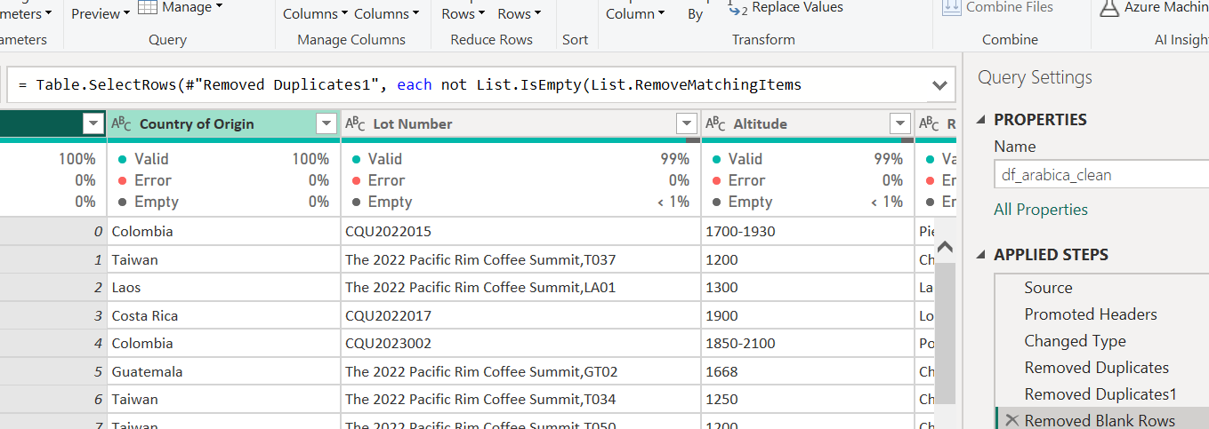
Data Preprocessing
Data Preprocessing is like Transforming the data by using Power Query Editor In power BI. After Loading the Data into power bi there is a option called transform Data which can directly Navigate to Power Query Editor.
The First Step is to check null and Blank values and Duplicates In the given data
Use first row as Headers
Remove Duplicates and Blanks by clicking Remove Rows
After Performing these Steps we need to check the every column to fill Blanks and Null values according to our analysis.
After Checking the Columns I use fill option to fill Null Values and Blank values is filled with “other” value.
In data , Color Column has same values with different patten so, I replace them with same pattern.

Slide 8
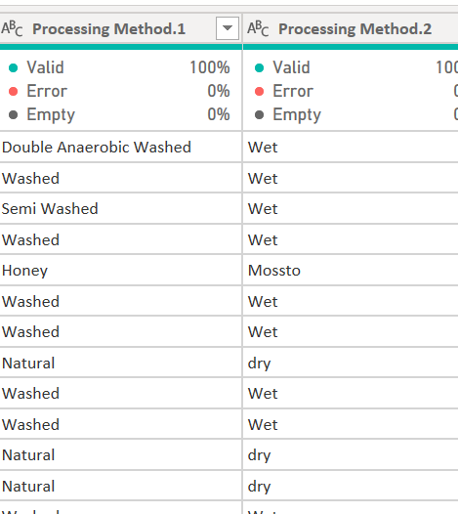
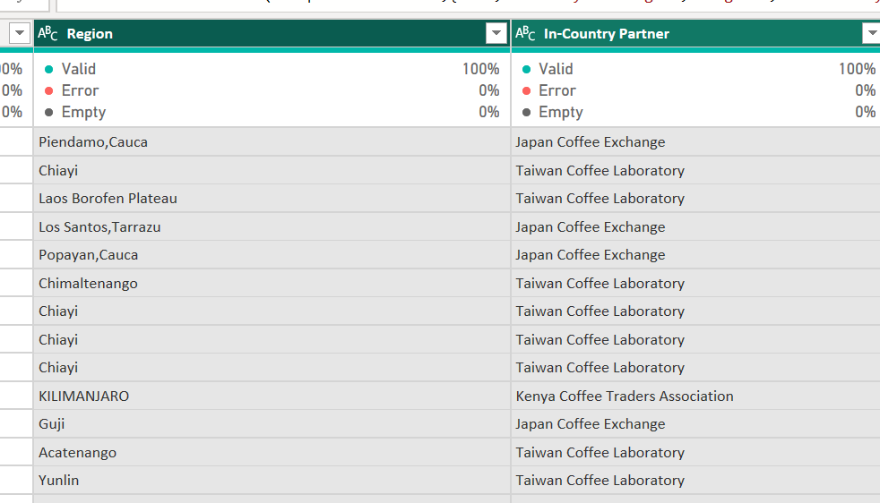
In Region and Country Partner Columns there are some Values which are in international Language so , I translated them into English and Replaced with English Names.
In Processing Method column, one row contains two values so, I split them by using specific Delimiter into Two different columns and fill the Null values using fill up option.
After Performing all the necessary steps in Query Editor, I click close and apply to apply all the transformations/changes to Data and it is updated in our Table View.

Slide 9
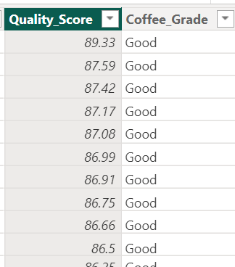
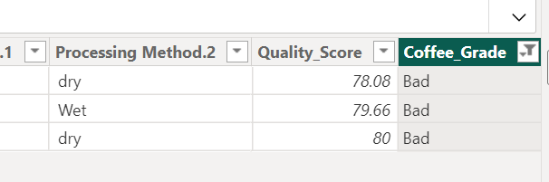
Creating a Coffee Grade Column:
After performing all necessary Transformation/Changes to Data and it is updated into Report and Table view.
I calculate the Coffee quality Scores based on Sensory Evaluation's and it is similar to total cup points
I created a Coffee Grade column to know the grade of Coffee by giving a condition
Coffee_Grade = IF(df_arabica_clean[Quality_Score] > 80,"Good","Bad")
By Grade column we can easily say most of the Coffee quality is Good there are very less percentage(only 3 rows) of Bad Quality.

Slide 10
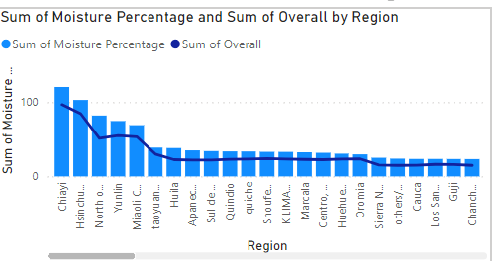
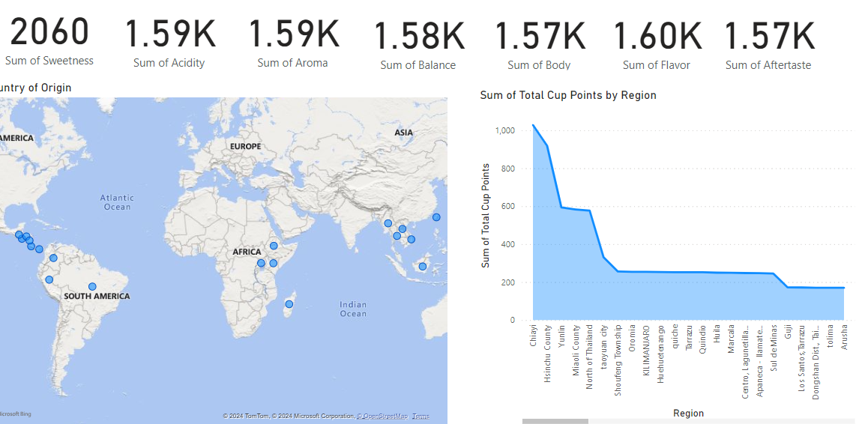
Visualization :
What are the key determinants of coffee quality as evaluated through sensory attributes such as aroma, flavor, acidity, etc.?
For Coffee Quality, Sensory Attributes are Most important along with Region because moisture percentage can also effect the quality of Coffee beans. here total cup points is total of all sensory attributes also called as Coffee Quality Score.
And Category one defect can Degrade the Quality of Coffee.
By visualization, we can see Moisture% is more in some of bars, when compared to others it’s very less in other Regions and bags

Slide 11
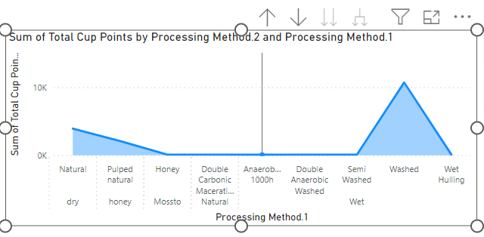
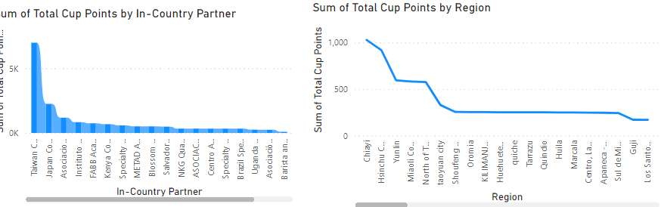
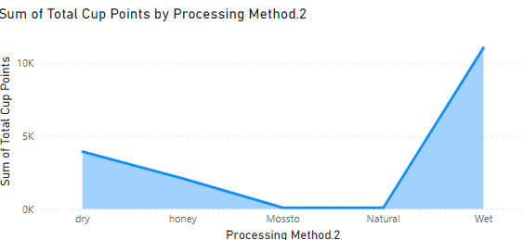
2 . Is there a correlation between processing methods, origin regions, and coffee quality scores?
yes, There is Relation between these columns and Coffee quality Score which can increase the Quality of Coffee, this can be Visualized by Line chart, Area Chart
Processing methods like wet, dry, wet hulling, washed etc., these methods have high total cup points which means High Coffee quality
I created a Hierarchy for processing methods column.
By observing the Visualization, we can see that quality score Decreases by region to region and country also.

Slide 12
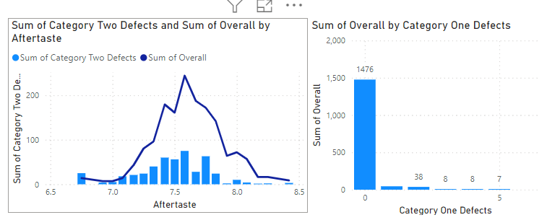
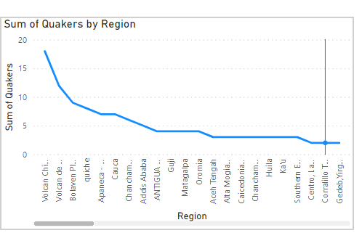
3. Can we identify any trends or patterns in defect occurrences and their impact on overall coffee quality?
There are two types of Defects Category one and Category Two
Category one- It’s occur during Visual inspection like damaged and insect beans
Category two- It’s occur due to over Fermentation, Staleness and Rancidness and also it can detect after tasting the coffee so I created a Visualization by including three attributes.
The Highest Score for Coffee in Category two is 7.58 as per Taste of Coffee.
So, these defects can occur during the first step of coffee making, we can reduce these defects by using High technology inspecting Machines or we need to be careful on picking Beans from different Regions.
Quakers can also one of the defect, because Quakers is a immature/unripe coffee bean which doesn’t contain enough sugars and these are difficult to identify during Inspection. As a result they often discovered during Roasting process and may Decrease Coffee Quality.

Slide 13
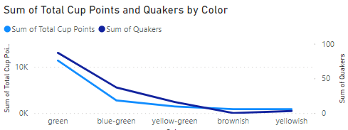
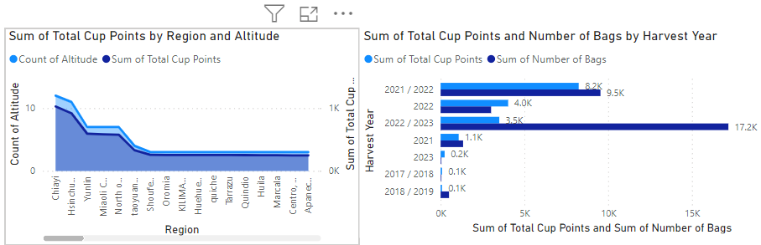
4. How do different variables interact to influence the Total Cup Points which represent an overall measure of coffee quality *. Quakers and sensory attributes(color, aftertaste, Aroma, flavor can influence the Total Cup Points because quakers are unripe beans. *. Altitude and Region also important for coffee quality because most of the region has high moisture percentage and it may vary in climate conditions which can spoil beans so it will impact the overall measure of coffee quality *.Processing method and sensory attributes with region can influence the coffee quality and Category two defects can decrease the coffee quality

Slide 14
Suggestions:
For Improving the Coffee Quality:
Sensory Attributes giving good result for all varieties of Coffee so, Eliminates Quakers before Roasting the Coffee so, it improves Quality of Coffee.
Choosing best Region and Altitude for Coffee Beans can reduce the Category one and Category two defects.
Implement a better inspection tools to pick out the damaged beans and after follow with Human inspection can be great for Coffee beans.
In this Dataset Uniformity and Sweetness of coffee are doing great so ,we need to concentrate on Aroma and Flavor, Aftertaste, Balance. When we roasting the beans make sure to note the temperature because it may vary from batch to batch and give a certain time to Cool the beans to proceed further.
Processing methods like natural, dry, washed, wet gives more cup points so following these methods for all coffee beans can increase the coffee quality.

Slide 15
thank you
.

